Slide 1


Emerald Green Power Ltd
Brandon Sew
30/07/24

Slide 2
Model so far:
Tabs: 10°C
Tdes: 90 °C
Stage 1
Stage 2
Ti0.8Zr0.2Mn0.8CrFe0.2
Low pressure candidate
TiMn1.66Vf0.34
High pressure candidate
Storage
20 bar
30-59 bar
66-223 bar
Candidates chosen based on use in previous empirical studies. LP contested by two studies.
For the two-stage system, a complete compression cycle consists of one individual hydrogenation (stage 1) with a subsequent sensible heating. The pressure inside stage 1 system after the sensible heating is at high level and thus, when the valve between stage 1 and stage 2 opens the hydrogen from stage 1 is entering the stage 2 and is stored.
After this coupling process between stage 1 and stage 2, the stage 2 system undergoes another sensible heating process. Finally, the stage 2 reactor releases hydrogen gas in a high-pressure tank.

Slide 3
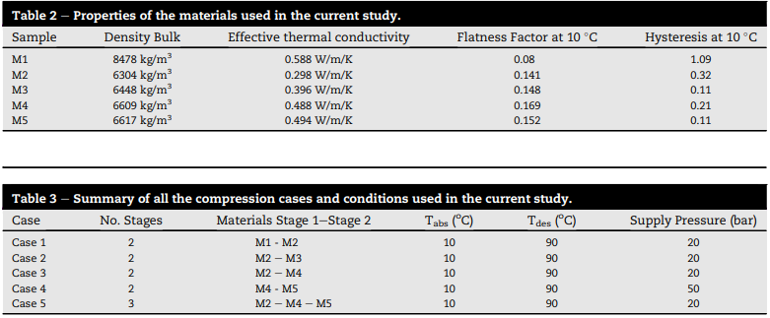
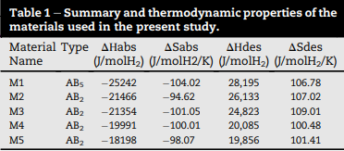
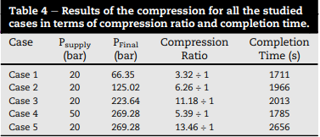
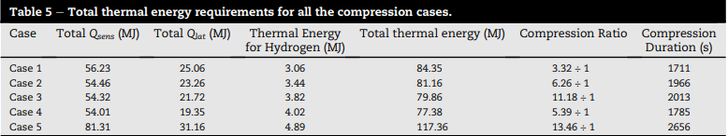
Justifications
Notes:
This study Measurement and the improvement of effective thermal conductivity for a metal hydride bed – a review - RSC Advances (RSC Publishing) states that TiMn1.66VF0.34 and Ti0.8Zr0.2Mn0.8CrFe0.2 could be any of the M1-5 above because the effective thermal conductivities of TiMn hydrides range from 0.2-1.3 or 0.05-1.2 for substituted TiMn as seen below.
Because of this, I only considered cases 1-3 in my model. Case 4 no because of different supply pressure and I wanted to keep it simple. Case 5 no because it isn’t a two stage system.
Since the alloys could be any of M1-5, I calculated the average thermal energy requirement provided by empirical evidence of cases 1-3 in the study as well as compression times.

Slide 4
Model calculations
Study uses 44-54kg of each alloy to compress 500g of H2 in an average cycle time of 1897 seconds (15.8 minute half cycle).
Since the alloys could be any of M1-5, I calculated the average thermal energy requirement provided by empirical evidence of cases 1-3 in the study to get an average thermal energy requirement of 81.79 MJ.
Assuming that the coil is made of SS because that is what the studies use and assuming an efficiency of 0.5-0.9 for practical purposes. For my model ive considered a 75% efficiency as its in the middle
As a result, you would need approximately 109.06 MJ of electrical energy to produce 81.79 MJ of thermal energy over 1897 seconds using SS helical coil.
Considering cost of electricity is 24.59p/kWh as of end of April 2024, cost of compression is £7.42 for one compression cycle lasting 31.6 minutes to compress 500g of hydrogen.
(https://energyguide.org.uk/average-cost-electricity-kwh-uk/)

Slide 5
References
Johnson, Terry A., Mallow, Anne M., Bowman, Robert C., Smith, D. Barton, Anovitz, Lawrence M., & Jensen, Craig M. Metal Hydride Compressor for High-Pressure (875 bar) Hydrogen Delivery. United States. https://doi.org/10.2172/1898257
https://www.hydrogen.energy.gov/docs/hydrogenprogramlibraries/pdfs/review19/in007_johnson_2019_o.pdf?sfvrsn=208b5c6f_1
Gkanas, E. et al. (2021) Study on the operation and energy demand of dual-stage Metal Hydride Hydrogen Compressors under effective thermal management, International Journal of Hydrogen Energy, Volume 46, Issue 57, Pages 29272-29287, ISSN 0360-3199, https://doi.org/10.1016/j.ijhydene.2021.02.062.

